Slide 1
Advanced data Security
Part II:
Communication Security
Chapter 9: Penetration Testing
1

Slide 2
Penetration testing
Penetration test or security testing.
Conducting a regular penetration test is a helpful way to identify serious
vulnerabilities within your IT environment.
A trusted ethical hacker performs the penetration test using a methodical and thorough approach.
Why does your technology and environment need penetration testing?
  Because every business has something to lose- and data is one of the most valuable assets that a hacker can gain. Whether through an application, device, or network.
  the data you are responsible for, is at risk when you don't verify the security measures protecting it.
Whose job is on the line if your clients' data (or your organization's other
assets) are compromised?
  Investing in penetration testing is one way to show clients, prospects, and competitors that you are willing to take every step necessary to safeguard
the data that has been entrusted to you.
2

Slide 3
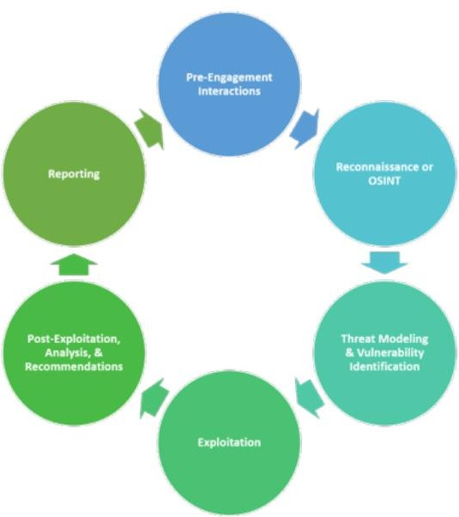
Phases of Penetration Testing

Slide 4
Phases of Penetration Testing(1)
The phases are critical to the successful planning and execution of a penetration test.
Pre-Engagement Interactions or Information gathering:
  During this pre-phase, a penetration testing company will outline the logistics of the test, expectations, legal implications, objectives and goals the customer would like to achieve.
  the penetration testers should work with company to fully understand any risks, the organizational culture, and the best pentesting strategy for the organization.
  You may want to perform a white box, black box, or gray box penetration test.
  The planning occurs along with aligning your goals to specific pentesting
outcomes.

Slide 5
Phases of Penetration Testing(2)
Reconnaissance or Open Source Intelligence (OSINT) Gathering:
  The whole point of this phase is getting to know the target.
  A pentester works on gathering as much intelligence on your organization and the potential targets for exploit.
  Who are the important people in the company?
    This can be answered by looking at the company web site or LinkedIn.
  Who do they do business with?
    they may be able to use social engineering, by make a few “sales calls” to the company.
  What public data is available about the company?
    Hackers collect IP address information and run scans to determine what hardware and software they are using.
  A pentester uses an exhaustive checklist for finding open entry
points and vulnerabilities within the organization.

Slide 6
Phases of Penetration Testing(2)
Reconnaissance or Open Source Intelligence (OSINT) Gathering:
  Common intelligence gathering techniques include:
    Search engine queries: a request for information that is made using a search engine.
    Domain name searches/WHOIS lookups: WHOIS Tool To See Who
Owns a Domain and Access Registration Data.
    Social Engineering
    Internet Footprinting – email addresses, usernames, social networks,
    Internal Footprinting –Ping sweeps, port scanning, reverse DNS, packet sniffing:
      Ping sweeps: a network scanning technique used to determine which of a range of IP addresses map to live hosts (computers).
      reverse DNS: If you type in an IP address, we will attempt to locate a dns PTR record for that IP address.

Slide 7
Phases of Penetration Testing(3)
Threat Modeling and Vulnerability Identification: (Discovery and Scanning – Vulnerability assessment)
  the tester identifies targets and maps the attack vectors. Any information gathered during the Reconnaissance phase is used to inform the method of attack during the penetration test.
  The most common areas a pentester will map and identify include:
    Business assets – identify and categorize high-value assets
      Employee data
      Customer data
      Technical data
    Threats – identify and categorize internal and external threats
      Internal threats – Management, employees, vendors, etc.
      External threats – Ports, Network Protocols, Web Applications, Network Traffic, etc..
  A pentester uses a vulnerability scanner to complete a discovery and inventory on the security risks posed by identified vulnerabilities.
– Then validates if the vulnerability is exploitable.
7

Slide 8
Phases of Penetration Testing(4)
Exploitation:
  the pentester begins to test the exploits found within your network, applications,
and data.
  The goal is for the ethical hacker is to see exactly how far they can get into your environment, identify high-value targets, and avoid any detection.
  Some of the standard exploit tactics include:
    Web Application Attacks: attempt by a malicious actor to compromise the security
of a Web-based application.
      target either the application itself to gain access to sensitive data,
      or use the application to launch attacks against users of the application.
    Network Attacks: attempt to gain unauthorized access to an organization's network,
with the objective of stealing data or perform other malicious activity.
    Memory-based attacks: exploit the most common vulnerability in applications (buffer overflows)
    Zero-Day Angle: an attack that exploits a potentially serious software security
weakness that the vendor or developer may be unaware of.
    Wi-Fi attacks, Physical Attacks, Social engineering

Slide 9
Phases of Penetration Testing(5)
Post-Exploitation, Risk Analysis and Recommendations:
  After the exploitation, the goal is to document the methods used to gain access to your organization’s valuable information.
  The penetration tester should be able to determine the value of the compromised systems and any value associated with the sensitive data captured.
  Some pentesters are unable to quantify the impact of accessing data or to provide recommendations on how to remediate the vulnerabilities within the environment.
  Make sure you ask a sanitized penetration testing report that clearly shows
recommendations for fixing security holes and vulnerabilities.
  Once the penetration testing recommendations are complete, the tester should:
    clean up the environment,
    reconfigure any access he/she obtained to penetrate the environment,
    prevent future unauthorized access into the system.

Slide 10
Phases of Penetration Testing(5cont)
Post-Exploitation, Risk Analysis & Recommendations:
  Typical cleanup activities include:
    Removing any executables, scripts, and temporary files from compromised systems
    Reconfiguring settings back to the original parameters prior to the
pentest
    Eliminating any rootkits installed in the environment
    Removing any user accounts created to connect to the compromised system

Slide 11
Phases of Penetration Testing(6)
Reporting:
  obtain written recommendations from the penetration testing company and have an opportunity to review the findings from the report with the ethical hacker(s).
  The findings and detailed explanations from the report will offer you insights and opportunities to improve your security posture.
  The report should show you exactly how entry points were discovered from the OSINT and Threat Modeling phase as well as how you can remediate the security issues found during the Exploitation phase.
  include a helpful overall security risk score.
  quality penetration testing report will also provide you with a roadmap of recommendations, mapping the major vulnerabilities to a defined timeline.

Slide 12
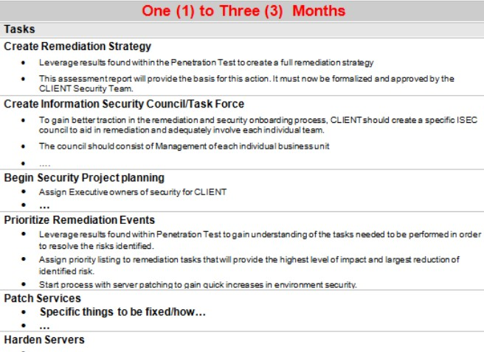
Phases of Penetration Testing(6)
6. Reporting:

Slide 13
Types of Penetration Testing
lntemal and Extemal Network Penetration Testing
Web Application Penetration Testing
Mobile Application (iOS or Android) Penetration Testing
Wireless Penetration Testing
API (REST or SOAP) Penetration Testing
Continuous Penetration Testing

Slide 14
Types of Penetration Testing(1)
Network Penetration Testing:
External threats to your network may seem more obvious than internal threats. If an external host is compromised, it can lead to an attacker digging deeper into your internal environment.
Port scans and other network service interaction and queries
Network sniffing, traffic monitoring, traffic analysis, and host discovery
Password cracking via capture and scanning of authentication databases
Buffer overruns
Spoofing or deceiving servers regarding network traffic

Slide 15
Types of Penetration Testing(2)
Web Application Penetration Testing:
Application Logic Flaw
Session Management
Cookie Manipulation
Brute-Force Attacks
Poor Server Configuration
File Upload/Download attack
Manipulation Injection Attacks for HTML,SQL
Manual Testing

Slide 16
Types of Penetration Testing(3)
Mobile Application (iOS or Android) Penetration Testing:
Identify and Protect Sensitive Data on Mobile Devices
Handle Password Credentials Securely on Mobile Devices
Ensure Sensitive Data is Protected in Transit
Implement User Authentication, Authorization, and Session Management Correctly Keep the Backend APIs (Services) and the Platform (Server) Secure
Secure Data Integration with Third-Party Services and Applications
Pay Specific Attention to the Collection and Storage of Consent for the Collection and Use of the User's Data
Implement Controls to Prevent Unauthorized Access to Paid-For Resources
Ensure Secure Distribution/Provisioning of Mobile Applications
16

Slide 17
Types of Penetration Testing(4)
Wireless Penetration Testing:
Rogue or Easily Accessible Access
Vendor-Supplied Defaults
Easy to Eavesdrop and/or Sniff
No Wireless Network Monitoring
Unauthorized, Slow Data Rates
Misconfigured Firewalls
WEP Weakness
Man-in-the-Middle Attacks
DoS Attacks
17

Slide 18
Types of Penetration Testing(5)
API (REST or SOAP) Penetration Testing:
APIs are the connective tissue responsible for transferring information between systems, both internally and externally.
Excessive Data Exposure
Lack of Resources and Rate Limiting
Security Misconfiguration Injection
Improper Assets Management
Insufficient Logging and Monitoring
18

Slide 19
Types of Penetration Testing(6)
Continuous Penetration Testing:
Applications change. Systems change. Networks change. Employees change.
Hackers change.
What happens when you connect a new API, add in a new server, or alter your environment in any way?
  A web application that was stable yesterday may not be with the next update.
So, why wouldn't you engage in continuous penetration testing?
  A standard penetration test is a snapshot of your security posture at the specific time of testing,
  whereas continuous penetration testing seeks to fill in the gaps between point-in-
time penetration testing.
Hacking attempts happen all the time, and so should penetration testing.
19

Slide 20
Action steps you should take when selecting a penetration testing vendor(1).
Determine Project Scope: to determine a framework for the work to be done.
Determine Specializations Needed: Every business and every industry is unique. Even within industries, businesses have different configurations. Multiple locations, open and closed systems, as well as customer, public-facing, and cloud-based applications can all play a role.
Perform Skills Evaluation: make sure that your prospective vendor has the skills you need to assess your specific systems.
Check Credentials And Certifications: Make sure that any company you are considering subscribes to the industry standard PTES (Penetration Testing Execution Standards).
  You want a team of experienced professionals who hold one or more professional certifications considered industry standard,
  as well as testing based on best practices, including OSSTM (Open Source Security
Testing Methodology) and OWASP (Open Web Application Security Project).
  you should also ask whether the vendor is certified or experienced with your specific situation.
20

Slide 21
Action steps you should take when selecting a penetration testing vendor(2).
Reputation And References: You want senior-level assessments from a highly professional company that has done business with others in your industry.
  It’s important to check reputation and references.
  Many companies will provide you a standard reference list, but make sure they can produce a list of actual clients.
Obtain Sample Reports: Ask to see sample reports to assess what type of information is delivered.
Make sure it’s not just full of industry jargon but provides easy-to-understand wording.
real value is in the evaluation of the results and the action plan developed to
address problems.
Determine Data Security: you will be opening up your systems to outsiders. you need to have a clear understanding of how data will be handled.
  This should include how data is accessed, transmitted, stored, and disposed of
when the job is finished.
  During the penetration testing, you should know who has access to the data and what records will be maintained.
21

Slide 22
Action steps you should take when selecting a penetration testing vendor(3).
Check For Liability Insurance: If a problem does occur, you want a vendor that has liability insurance to remedy the situation and mitigate any losses that result from their testing.
  The vendor you choose needs to be able to provide you with proof of insurance sufficient to cover potential losses that might occur if your data or environment is compromised as a result of the pen test.
Define The Rules Of Engagement: clearly define the rules of engagement. A contract should detail the exact scope of the work and any limitations.
Ex: there may be times where certain systems will be unavailable for testing due to business concerns and production schedules. These rules should be spelled out in advance to avoid delays and misunderstandings.
Define Clear Expectations: Both parties need to be clear about what deliverables are expected. There are options to determine the level and frequency of services provided, including one-time testing, follow-ups, ongoing testing, and on-demand services. Each option will deliver different solutions.
  Be clear up front to avoid frustrations and misunderstandings later.
22

